Slide 1
BM329 workshop B
Dr. Morgan Feeney, Prof. Paul Hoskisson, Dr. Leighton Pritchard

Slide 2
Learning Objectives
After this workshop, students will be able to:
Describe influenza virus particles and how they replicate
Explain the role that antigenic shift and antigenic drift play in influenza virus evolution
Discuss the effects of vaccination and antiviral drugs on influenza virus evolution and public health
Build phylogenetic trees representing the evolution of influenza viruses

Slide 3
Influenza virus causes seasonal and pandemic flu
Negative-strand RNA virus; orthomyxovirus
Virion has helical symmetry, but in reality amorphous appearance
Segmented genome
8 separate RNAs, 890-2341 nucleotides
Influenza A, B & C
Influenza A is key cause of ‘flu [seasonal ‘flu kills avg. 400k/year; pandemic ‘flu can kill millions more]
Influenza A subtypes based on H and N proteins
Hemagglutinin (H1 – 18): Sialic acid binding protein (lectin), key determinant of host specificity
Neuraminidase (N1 – 11): Sialidase, key role in virus assembly
H1N1 and H3N2 are most common circulating subtypes that cause disease in humans

Slide 4
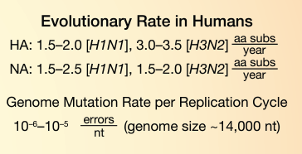
Influenza virus replication
Negative sense mRNA virus
RNA-dependent RNA polymerase – no proofreading
8 genome segments – must be packaged correctly to form an infectious virion

Slide 5
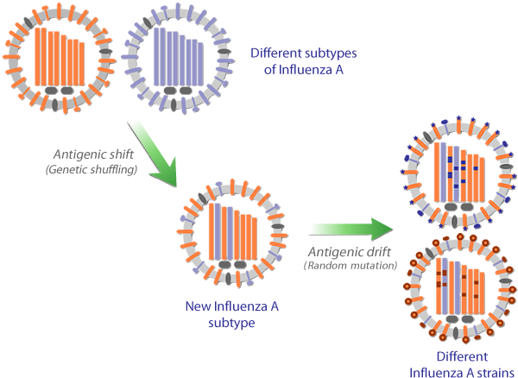
Virus evolution by antigenic shift and antigenic drift

Slide 6
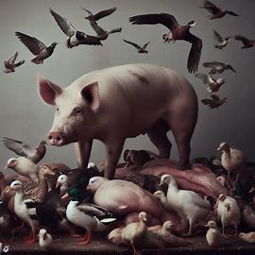
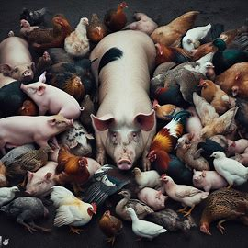
Swine and bird flu
Image credit: Microsoft Bing

Slide 7
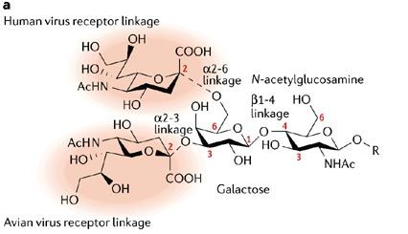
Hemagglutinin specificity and the “mixing bowl” theory
H1N1 (human) viruses: bind α-2,6 linked sialic acid
The major linkage in human respiratory epithelia
Some α-2,3 linked sialic acid is present
H5N1 (avian): bind α-2,3 linked
The major linkage in the e.g. duck gut
Pig trachea: both linkages present
Co-infection with H1N1 and H5N1 could occur in pigs or humans
Recombination with flu/swine flu
(“mixing bowl” theory) → generate new variants (potentially more deadly, pandemic strains)

Slide 8

Workshop overview – modelling influenza evolution
You will each be given a chance to assemble a ‘flu virus particle and we will monitor the spread of these viruses in the class
Envelope = virus capsid
Paper strips = virus genome segments
[need 8 for a correctly assembled, infective virus particle - PB1, PB2, PA, NP, HA, NA, M, and NS]
- each strip is labelled with the genome segment name and allele
-e.g., “PB1 – A” is segment PB1, allele A
We will model antigenic drift (random mutations) and antigenic shift (reassortment)

Slide 9
Workshop instructions
Work in pairs – everyone should find a partner. Each pair should join a larger group (8-12 people total).
Each round consists of 3 actions:
Acquire a new ‘flu virus [in the first round, do this by drawing randomly from the pool of available viruses; in subsequent rounds, do this by passing viruses clockwise in your group]
Determine the outcome of the virus infection [roll the die]
Replicate the virus (or not) depending on the outcome of the roll [Table 1 instructions].
You should play until you have six viral genotypes recorded in Table 2.
Make sure you record each genome (allele #s) in Table 2 in the handout!

Slide 10
Fill out Table 2 – it should look something like this!
virus isolate # | PB2 | PB1 | PA | NP | HA | NA | M | NS
MF1 | D | B | B | B | N | F | C | C
MF2 | D | B | A | A | B | E | A | E
MF3 | B | C | B | A.1 | C | P | A | D
MF4 | D | B | B.1 | B | N | F | C | C
MF5 | C | A | A.1 | A | I | G | E | E
MF6 | C | A | A.1 | A | I | G | E | E

Slide 11


Slide 12
Build a UPGMA tree showing the evolutionary relationships between your viruses
Leighton to please review/confirm these instructions?

Slide 13
Your Table 2 should look something like this – use to calculate pairwise differences
virus isolate # | PB2 | PB1 | PA | NP | HA | NA | M | NS
MF1 | D | B | B | B | N | F | C | C
MF2 | D | B | A | A | B | E | A | E
MF3 | B | C | B | A.1 | C | P | A | D
MF4 | D | B | B.1 | B | N | F | C | C
MF5 | C | A | A.1 | A | I | G | E | E
MF6 | C | A | A.1 | A | I | G | E | E

Slide 14
Use Table 2 to count pairwise differences
virus isolate # | PB2 | PB1 | PA | NP | HA | NA | M | NS
MF1 | D | B | B | B | N | F | C | C
MF2 | D | B | A | A | B | E | A | E
Look at the pairwise difference between isolate MF1 and isolate MF2
-They have the same allele for PB2, and also for PB1
-PA, NP, HA, NA, M, and NS have different alleles
-The total number of differences is 6 [the number of alleles that are different]

Slide 15
Count the number of differences between each of the virus isolates (Fill in Table 3).
 | MF1 | MF2 | MF3 | MF4 | MF5 | MF6
MF1 | 0 | 6
MF2 |  | 0
MF3 |  |  | 0
MF4 |  |  |  | 0
MF5 |  |  |  |  | 0
MF6 |  |  |  |  |  | 0

Slide 16
Your table 3 should look something like this.
 | MF1 | MF2 | MF3 | MF4 | MF5 | MF6
MF1 | 0 | 6 | 7 | 8 | 8 | 8
MF2 |  | 0 | 7 | 6 | 6 | 6
MF3 |  |  | 0 | 8 | 8 | 8
MF4 |  |  |  | 0 | 8 | 8
MF5 |  |  |  |  | 0 | 0
MF6 |  |  |  |  |  | 0
The bottom half of the table will be symmetrical with the top.
Sanity check: all the numbers you enter should be integers 0-8

Slide 18
Fill in Table 4
 | 0
 |  | 0
 |  |  | 0
 |  |  |  | 0
 |  |  |  |  | 0

Slide 19
Your Table 4 should look something like this
 | 0
 |  | 0
 |  |  | 0
 |  |  |  | 0
 |  |  |  |  | 0

Slide 21
Fill in Table 5
 | 0
 |  | 0
 |  |  | 0
 |  |  |  | 0

Slide 22
Your Table 5 should look something like this
 | 0
 |  | 0
 |  |  | 0
 |  |  |  | 0

Slide 24
Fill in Table 6
 | 0
 |  | 0
 |  |  | 0

Slide 25
Your Table 6 should look something like this
 | 0
 |  | 0
 |  |  | 0

Slide 27
Fill in Table 7
 | 0
 |  | 0

Slide 28
Your Table 7 should look something like this
 | 0
 |  | 0

Slide 31
Compare phylogenetic trees
Share your phylogenetic trees to compare how evolution has occurred in different groups for all three rounds
Discuss:
How well do the phylogenetic trees you have drawn reflect ‘flu evolution in the different scenarios? How do these compare to evolution in the real world?
How might you model the evolution of these ‘flu viruses (apart from using UPGMA?)
How might the next pandemic strain of ‘flu evolve?

Slide 32
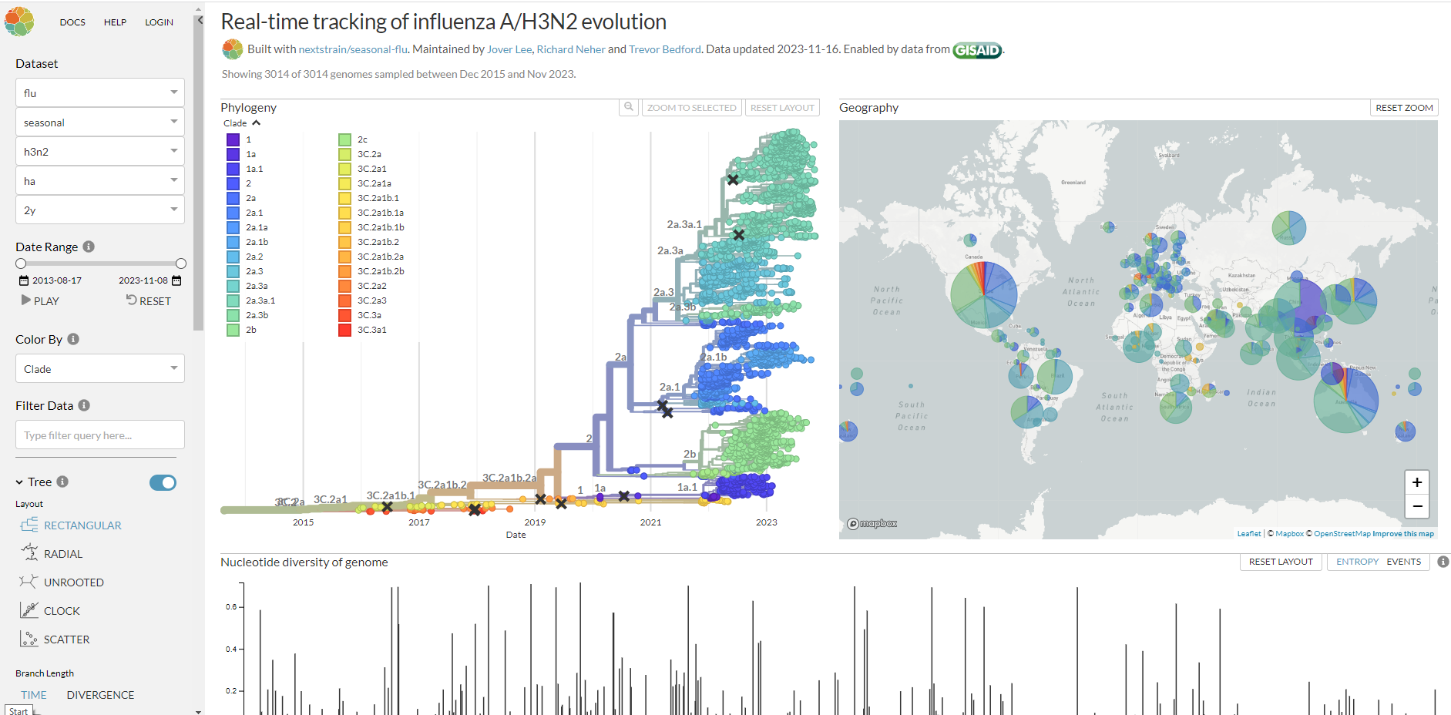

Slide 33
This round will demonstrate the effect of vaccination on ‘flu infection and evolution

Slide 34
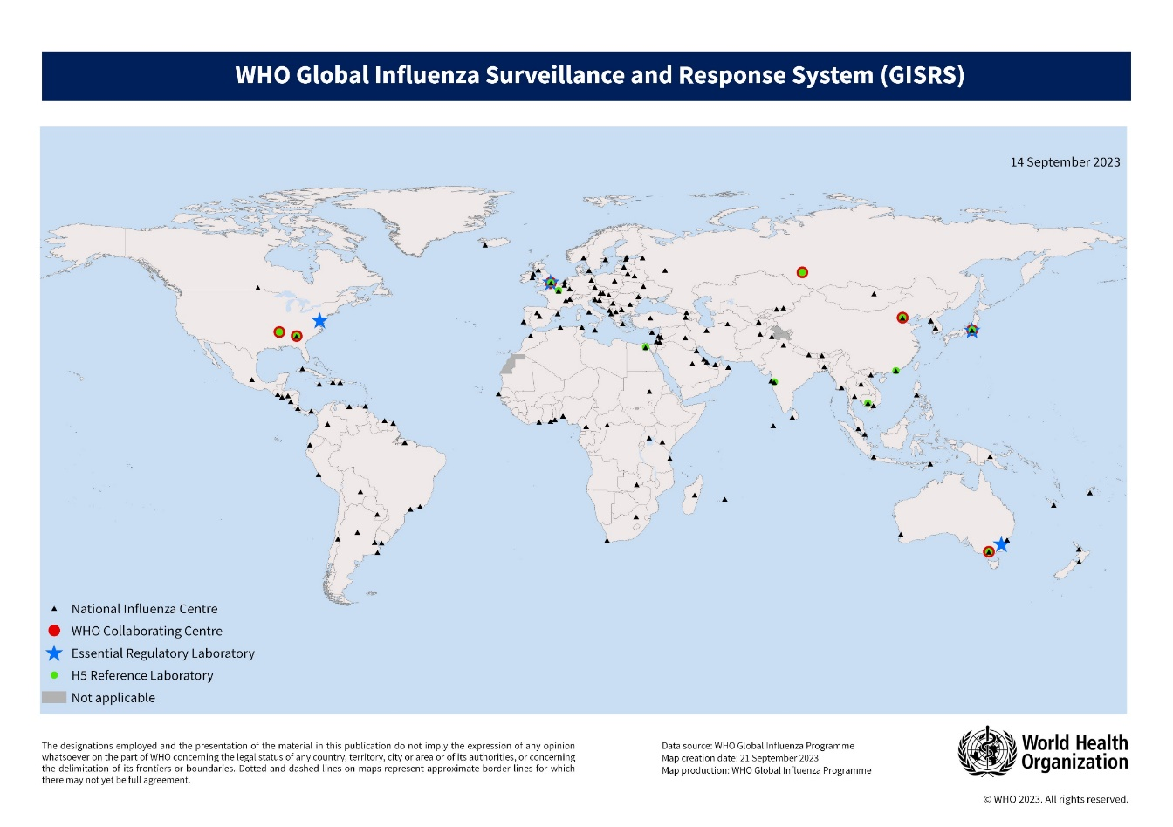
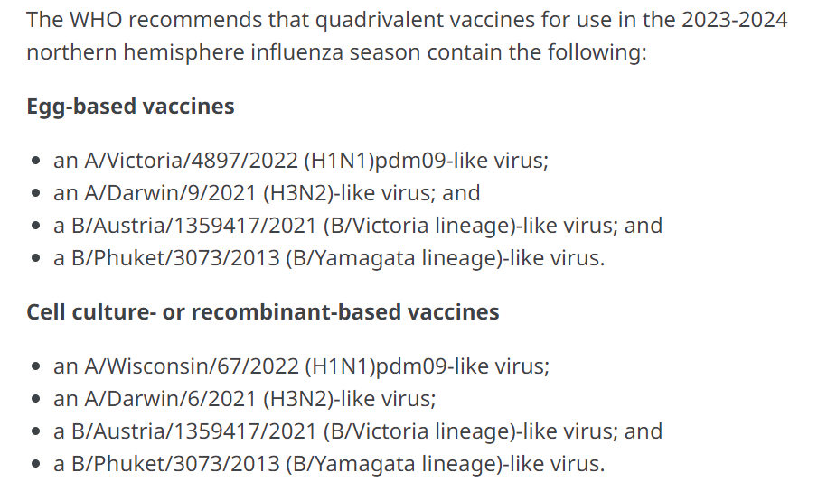
Influenza surveillance and response (WHO)
Global monitoring identifies major circulating strains
WHO panel meets to appraise evidence and recommendations from GISRS
Strains for that year’s vaccine are selected: Feb (Northern hemisphere), Sep (Southern hemisphere)
Sent to vaccine manufacturers
Vaccines prepared for use in the flu season
If a novel strain appears subsequent to this, vaccine unlikely to be protective

Slide 35
Our GISRS group must decide, based on evidence, which influenza strains to include in the vaccines for the coming ‘flu season
Choose 2 influenza A subtypes (other 2 in the quad. vaccine will be B types)

Slide 36
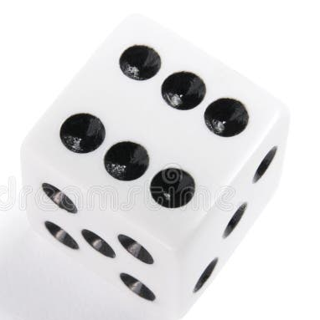
Infection Round 2
Roll 1: infection?
Roll 2: outcome?
Repeat virus evolution with new rules:
Roll a die to determine if you are infected or not.
vaccine-derived immunity: vaccine subtypes do not infect/replicate; virus types not found in the vaccine can still infect/replicate
If infected, roll again to determine the outcome of the infection. (Continue to add mutations as usual)

Slide 37
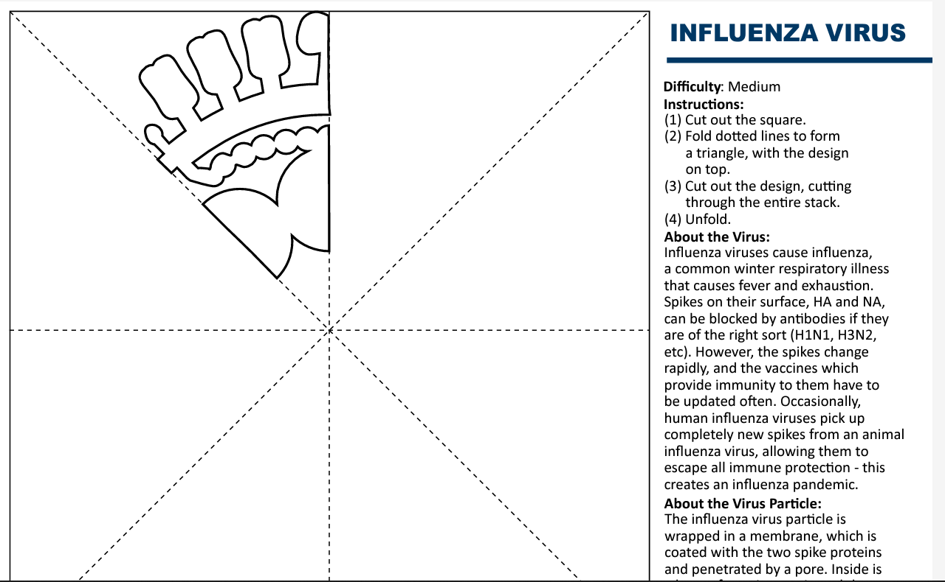
Further reading
Petrova VN, Russell CA. The evolution of seasonal influenza viruses. Nat Rev Microbiol. 2018;16(1):47-60. doi:10.1038/nrmicro.2017.118
Han AX, de Jong SPJ, Russell CA. Co-evolution of immunity and seasonal influenza viruses. Nat Rev Microbiol. 2023;21(12):805-817. doi:10.1038/s41579-023-00945-8
Chen KY, Karuppusamy J, O'Neill MB, et al. High-throughput droplet-based analysis of influenza A virus genetic reassortment by single-virus RNA sequencing. Proc Natl Acad Sci U S A. 2023;120(6):e2211098120. doi:10.1073/pnas.2211098120
Xie R, Edwards KM, Wille M, et al. The episodic resurgence of highly pathogenic avian influenza H5 virus. Nature. 2023;622(7984):810-817. doi:10.1038/s41586-023-06631-2
Dzau V, Yadav P. The influenza imperative: we must prepare now for seasonal and pandemic influenza. Lancet Microbe. 2023;4(4):e203-e205. doi:10.1016/S2666-5247(23)00013-7
FluNet: https://www.who.int/tools/flunet
NextStrain: https://nextstrain.org/flu/seasonal/h3n2/ha/2y
Make your own influenza virus snowflake →
https://cvr-engagement.co.uk/virus-snowflakes

